Slide 1


Anthony Doyle
10th July 2024

Slide 2

Outline
Executive Summary
Introduction
Methodology
Results
Conclusion
Appendix

Slide 3
Executive Summary
Summary of methodologies
Data Collection – gathering historical data on the Space X Falcon 9 launches with a view to understanding the success or failure of first stage landings.
Feature Selection – Extract relevant data that impact on successful landings such as payload details, orbit types, and location of launch.
Model Selection – Use supervised learning algorithms to classify the data (logistic regression, support vector machines, decision tree, and K nearest neighbor) to train predictive models.
Summary of all results
The decision tree algorithm scored the highest in terms of percentage of correct predictions on the test data.

Slide 4
Introduction
Project background and context
Space Y would like to compete with Space X.
SpaceX advertises Falcon 9 rocket launches on its website with a cost of 62 million dollars; other providers cost upward of 165 million dollars each.
The purpose of this project is to gather information about Space X from past launch data. Space X are able to significantly reduce the cost of missions compared to their competitors, due to the ability to reuse the first stage of the launch.
The project hopes to define a predictive model that can determine the cost of a launch based on specific parameters.
Problems you want to find answers
Prediction of successful first landing
Cost estimation for future launches
Notes:
Space Y would like to compete with Space X
Gather information about Space X from past launch data
Determine if Space X will use the first stage
Determine the price of each launch
In this capstone, we will predict if the Falcon 9 first stage will land successfully. SpaceX advertises Falcon 9 rocket launches on its website with a cost of 62 million dollars; other providers cost upward of 165 million dollars each, much of the savings is because SpaceX can reuse the first stage. Therefore if we can determine if the first stage will land, we can determine the cost of a launch. This information can be used if an alternate company wants to bid against SpaceX for a rocket launch. In this lab, you will collect and make sure the data is in the correct format from an API. The following is an example of a successful and launch.

Slide 5

Section 1

Slide 6
Methodology
Executive Summary
Data collection methodology:
Describe how data was collected
Perform data wrangling
Describe how data was processed
Perform exploratory data analysis (EDA) using visualization and SQL
Perform interactive visual analytics using Folium and Plotly Dash
Perform predictive analysis using classification models
How to build, tune, evaluate classification models

Slide 7
Data Collection
Describe how data sets were collected.
You need to present your data collection process use key phrases and flowcharts

Slide 8
Data Collection – SpaceX API
Present your data collection with SpaceX REST calls using key phrases and flowcharts
The GitHub URL of the completed SpaceX API calls notebook.
The Final CSV Output
Request rocket launch data from the SpaceX API
Perform Get Request to obtain Launch Data
Review Result by calling the Json Method
"https://api.spacexdata.com/v4/launches/past"
Response=requests.get(URL)
Response.Json()
Used the API to obtain further Launch Data
Create Lists & Combined Data into Dictionary
Create Pandas Data Frame
Rocket, payloads, launchpad, and cores.
Filter on Falcon 9 Launches
Resolve Missing Values
Export to CSV
Notes:
Space X API End Point/URL https://api.spacexdata.com/v4
Start Requesting Data from spacex_url="https://api.spacexdata.com/v4/launches/past"

Slide 9
Data Collection - Scraping
Web scraping process
The GitHub URL of the completed web scraping notebook
The final CSV Output
Define Helper Functions
Request the Falcon9 Launch Wiki page from its URL
Create a Beautiful Soup Object from the Response
Date/Time, Booster Versions, Landing Status, Get Mass, and Extract Column from Header
Extract all the Column /Variable Names from the HTML Table Header
Create a Data Frame by parsing the launch HTML tables
Record Values in a Dictionary
Export to CSV

Slide 10
Data Wrangling
Describe how data were processed
You need to present your data wrangling process using key phrases and flowcharts
Add the GitHub URL of your completed data wrangling related notebooks, as an external reference and peer-review purpose

Slide 11
EDA with Data Visualization
Summary of key charts
Scatterplot showing the relationship between Payload mass and flight numbers, overlaid with the outcome of each launch
Scatterplot showing the relationship between the launch site and the flight number, overlaid with the outcome of each launch.
Scatterplot showing the relationship between the launch site and the payload mass, overlaid with the outcome of each launch.
Bar chart plotting the success rate of each Launch by Orbit Type
Scatterplot showing the relationship between the payload mass and the orbit type, overlaid with the outcome of each launch.
A line plot showing the average success rate trend
The GitHub URL of completed EDA with data visualization notebook.
The final CSV output

Slide 12
EDA with SQL
Summary of the SQL queries
Select Distinct to provide the unique list of launch sites in the space mission
Select Statement Limited to the first 5 launch sites beginning with ‘CCA’
Select Statement to display the total payload mass carried by boosters launched by NASA (CRS)
Select Statement to display the average payload mass carried by booster version F0 v1.1
Select Min Statement to list the date when the first successful landing outcome in ground pad was achieved
Select Statement listing the names of the boosters which have success in drone ship and have payload mass greater than 4000 but less than 6000
Select Statement listing the total number of successful and failure mission outcomes
Select Statement listing the names of the booster versions which have carried the maximum payload mass.
Select Statement listing the records which will display the month names, failure landing outcomes in drone ship ,booster versions, launch site for the months in year 2015.
Select Statement Rank the count of landing outcomes (such as Failure (drone ship) or Success (ground pad)) between the date 2010-06-04 and 2017-03-20, in descending order.
The GitHub URL of your completed EDA with SQL notebook.

Slide 13
Build an Interactive Map with Folium
Summarize what map objects such as markers, circles, lines, etc. you created and added to a folium map
Marked the 4 launch sites on the folium map, using coordinates, map object, folium circles, and folium markers.
Marked the success and failure launches for each site on the map, using the class column indicator, and red & green folium markers to signify success or failure
Calculated the distance between launch sites and proximities, using the coordinates, the distance function, and polylines to illustrate the distance.
The GitHub URL of your completed interactive map with Folium map.

Slide 14
Build a Dashboard with Plotly Dash
Summarize what plots/graphs and interactions you have added to a dashboard
Explain why you added those plots and interactions
Add the GitHub URL of your completed Plotly Dash lab, as an external reference and peer-review purpose

Slide 15
Predictive Analysis (Classification)
Load Data Frame
Create Numpy X & Y Arrays
Standardise Data in X
Use Function to Train_test_split Data into Training and Test Data
Create Logistic Regression Model
Create SVM Model
Create Decision Tree Model
Create KNN Model
Select Model with Best Accuracy
Test Model Accuracy
Test Model Accuracy
Test Model Accuracy
Test Model Accuracy
The GitHub URL of your completed predictive analysis lab.

Slide 16
Results
Exploratory data analysis results
Interactive analytics demo in screenshots
Predictive analysis results

Slide 17

Section 2

Slide 18
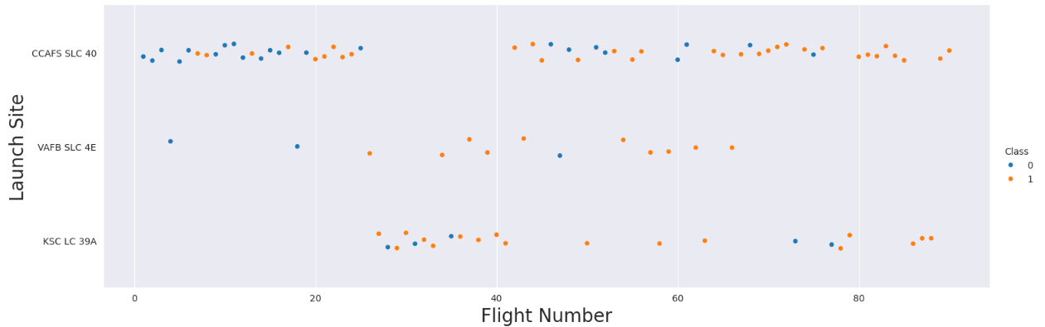
Flight Number vs. Launch Site
The scatter plot of Flight Number vs. Launch Site indicates CFAS SLC 40 has a higher success rate after 60 continuous flights

Slide 19
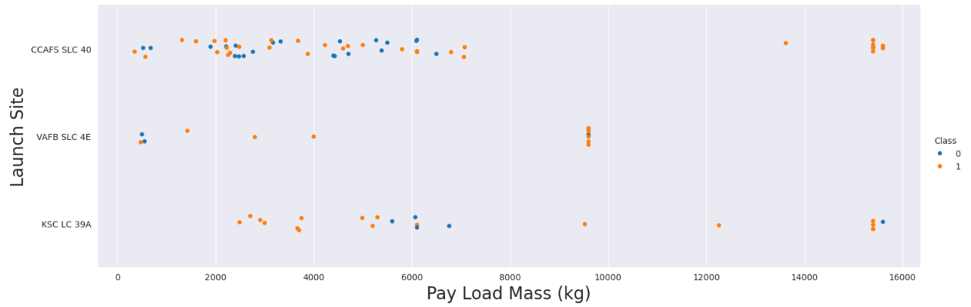
Payload vs. Launch Site
The Payload Vs. Launch Site scatter point chart indicates for the VAFB-SLC
launch site there are no rockets launched for heavy payload mass(greater than 10000)

Slide 20
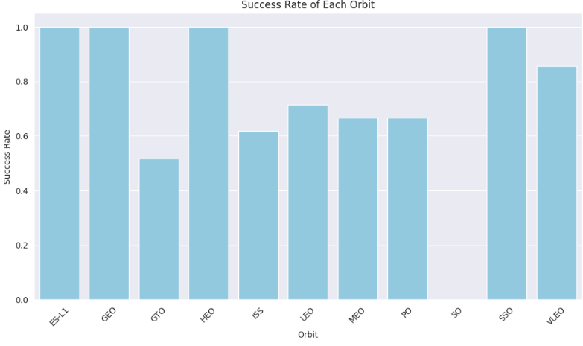
Success Rate vs. Orbit Type
The ES L1, GEO, HEO, and SSO have the highest chance of success

Slide 21
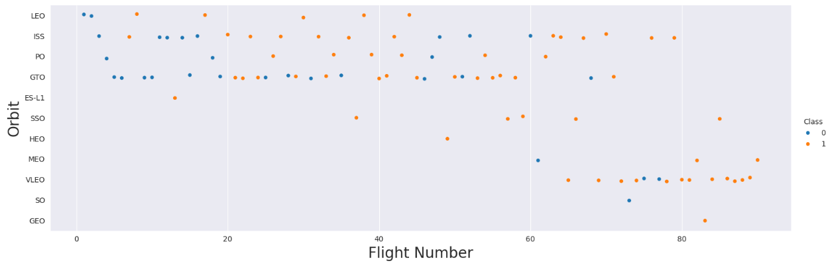
Flight Number vs. Orbit Type
You should see that in the LEO orbit the Success appears related to the number of flights; on the other hand, there seems to be no relationship between flight number when in GTO orbit.

Slide 22
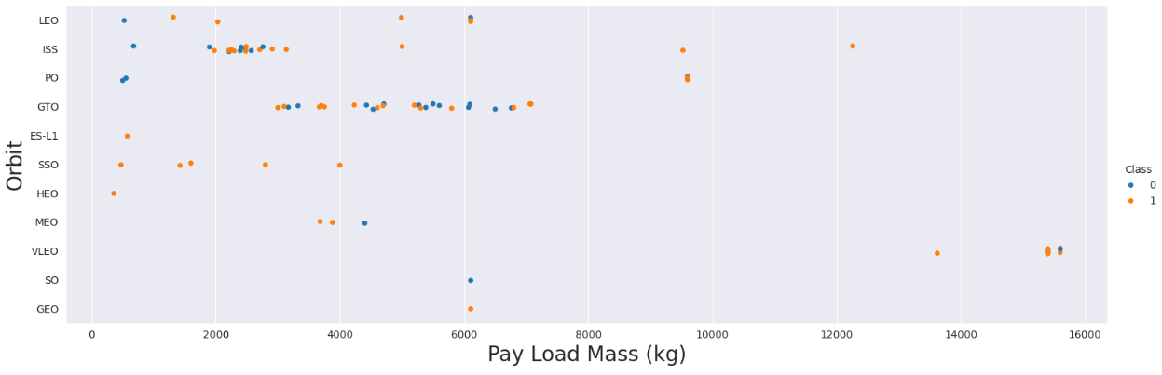
Payload vs. Orbit Type
With heavy payloads the successful landing or positive landing rate are more for Polar,LEO and ISS. However for GTO we cannot distinguish this well as both positive landing rate and negative landing(unsuccessful mission) are both there here.

Slide 23
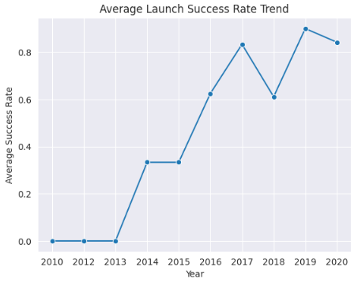
Launch Success Yearly Trend
You can observe that the success rate since 2013 has continued to improve

Slide 24
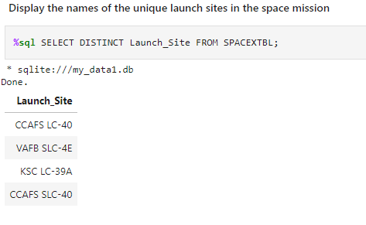
All Launch Site Names
The names of the unique launch sites

Slide 25
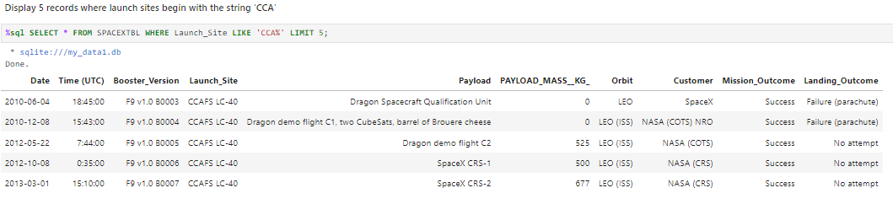
Launch Site Names Begin with 'CCA'
5 records where launch sites begin with `CCA`

Slide 26
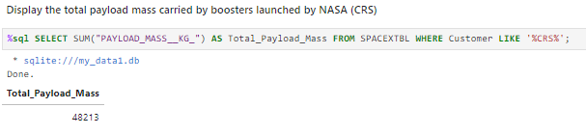
Total Payload Mass
Calculate the total payload carried by boosters from NASA

Slide 27
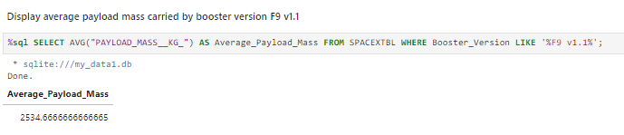
Average Payload Mass by F9 v1.1
Calculate the average payload mass carried by booster version F9 v1.1

Slide 28
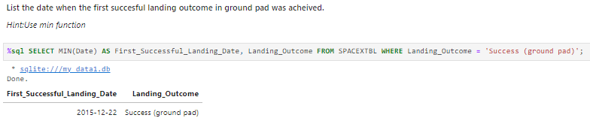
First Successful Ground Landing Date
Find the dates of the first successful landing outcome on ground pad

Slide 29
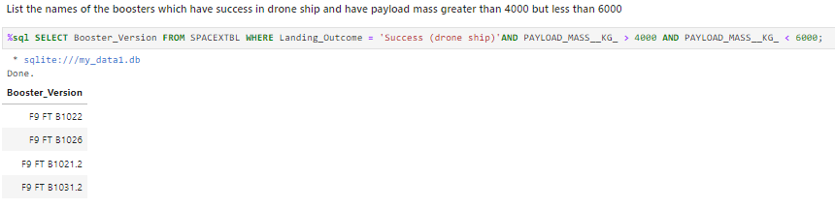
Successful Drone Ship Landing with Payload between 4000 and 6000
List the names of boosters which have successfully landed on drone ship and had payload mass greater than 4000 but less than 6000

Slide 30
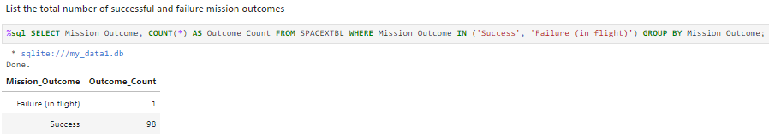
Total Number of Successful and Failure Mission Outcomes
Calculate the total number of successful and failure mission outcomes

Slide 31
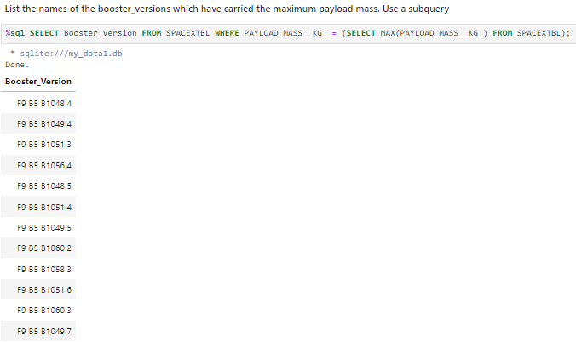
Boosters Carried Maximum Payload
List the names of the booster which have carried the maximum payload mass

Slide 32
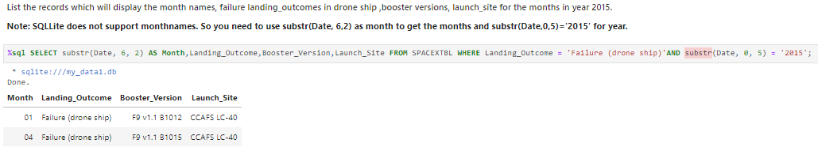
2015 Launch Records
List the failed landing_outcomes in drone ship, their booster versions, and launch site names for in year 2015

Slide 33
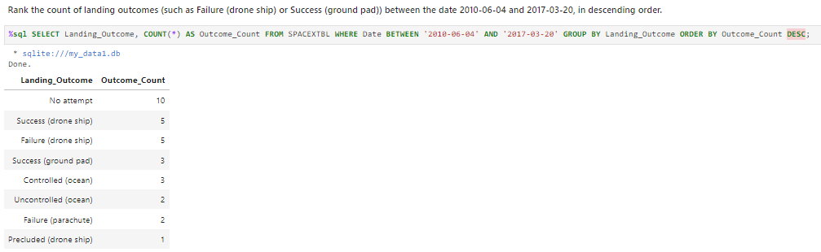
Rank Landing Outcomes Between 2010-06-04 and 2017-03-20
Rank the count of landing outcomes (such as Failure (drone ship) or Success (ground pad)) between the date 2010-06-04 and 2017-03-20, in descending order

Slide 34

Section 3

Slide 35
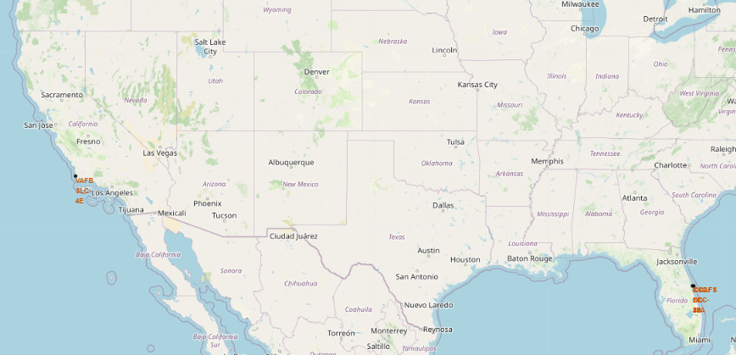
Launch site Locations
All the launch sites are situated approx. 30 degrees above the Equator line.
All the launch sites are within close proximity to the coast. There are 4 launch sites, 1 situated on the West Coast, 3 situated on the East Coast

Slide 36
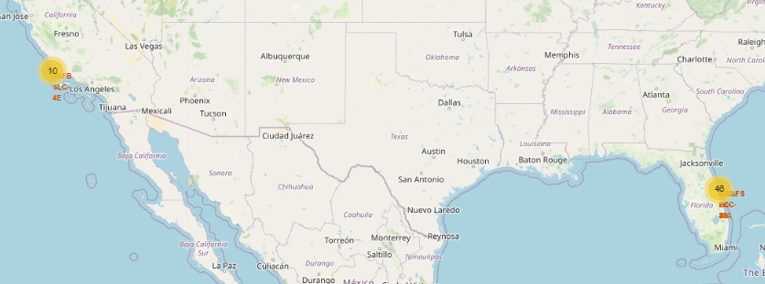
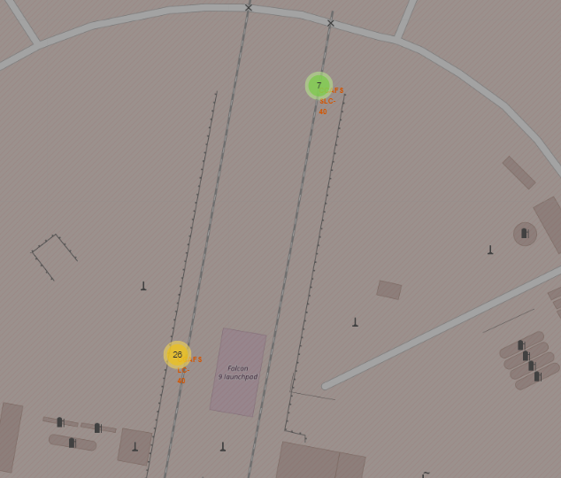
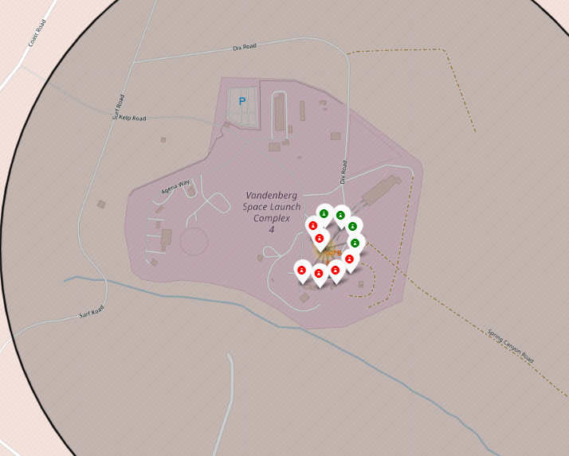
Launch Success Rates
CCAFS SLC-40 has a higher rate of success indicated by the green marker cluster on the map.

Slide 37
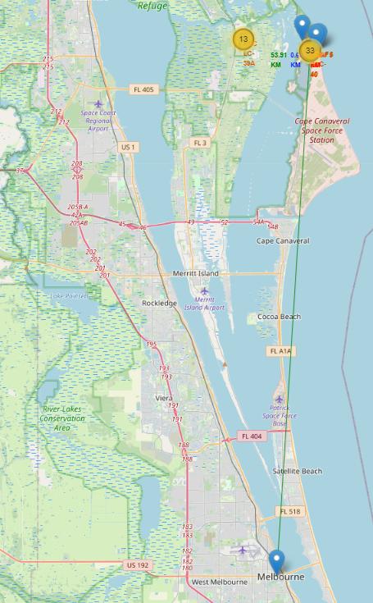
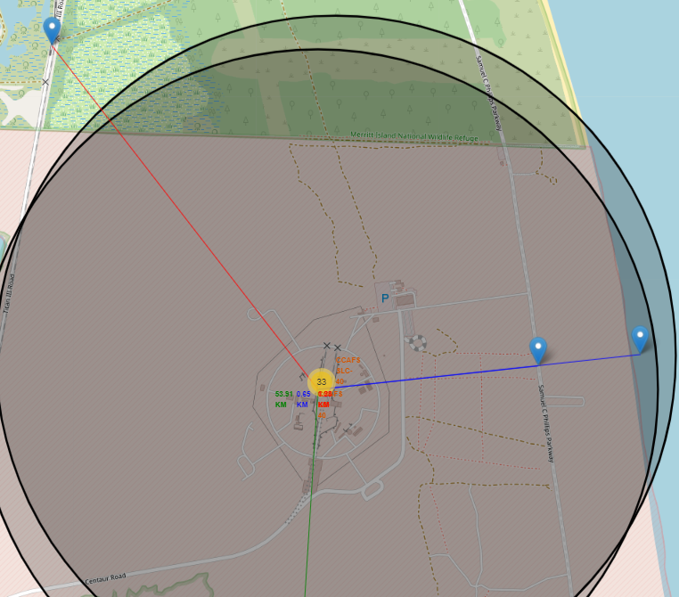
Launch Site Proximity to Prominent Features
The distance from the launch site to the closest coastline is approximately 0.95 kilometers.
The distance from the launch site to the closest railway is approximately 1.28 kilometers.
The distance from the launch site to the closest highway is approximately 0.65 kilometers.
The distance from the launch site to the closest city is approximately 53.91 kilometers.

Slide 38

Section 4

Slide 39
<Dashboard Screenshot 1>
Replace <Dashboard screenshot 1> title with an appropriate title
Show the screenshot of launch success count for all sites, in a piechart
Explain the important elements and findings on the screenshot

Slide 40
<Dashboard Screenshot 2>
Replace <Dashboard screenshot 2> title with an appropriate title
Show the screenshot of the piechart for the launch site with highest launch success ratio
Explain the important elements and findings on the screenshot

Slide 41
<Dashboard Screenshot 3>
Replace <Dashboard screenshot 3> title with an appropriate title
Show screenshots of Payload vs. Launch Outcome scatter plot for all sites, with different payload selected in the range slider
Explain the important elements and findings on the screenshot, such as which payload range or booster version have the largest success rate, etc.

Slide 42

Section 5

Slide 43
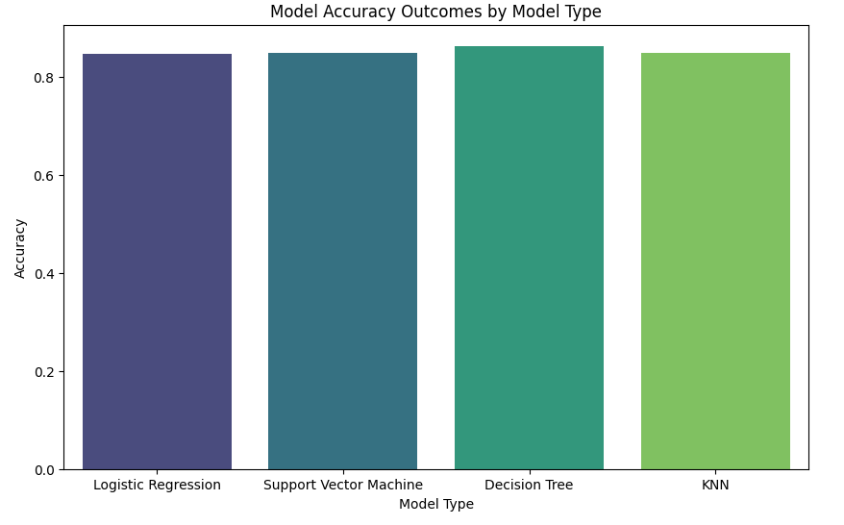
Classification Accuracy
The Decision Tree Model is the most accurate with a score of 0.863

Slide 44
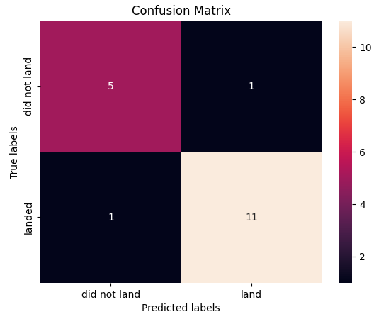
Confusion Matrix
The confusion matrix of the best performing model. The model has a high number of true positives, and accurately predicted true negatives in most cases.

Slide 45
Conclusions
The CCAFS SLC 40 site has the highest success rate for recovery of first stage launches
The success rate of the CCAFS SLC 40 site improves with each flight

Slide 46
Appendix
Include any relevant assets like Python code snippets, SQL queries, charts, Notebook outputs, or data sets that you may have created during this project

Slide 47


